Slide 1
Water sports in Hungary

Slide 2
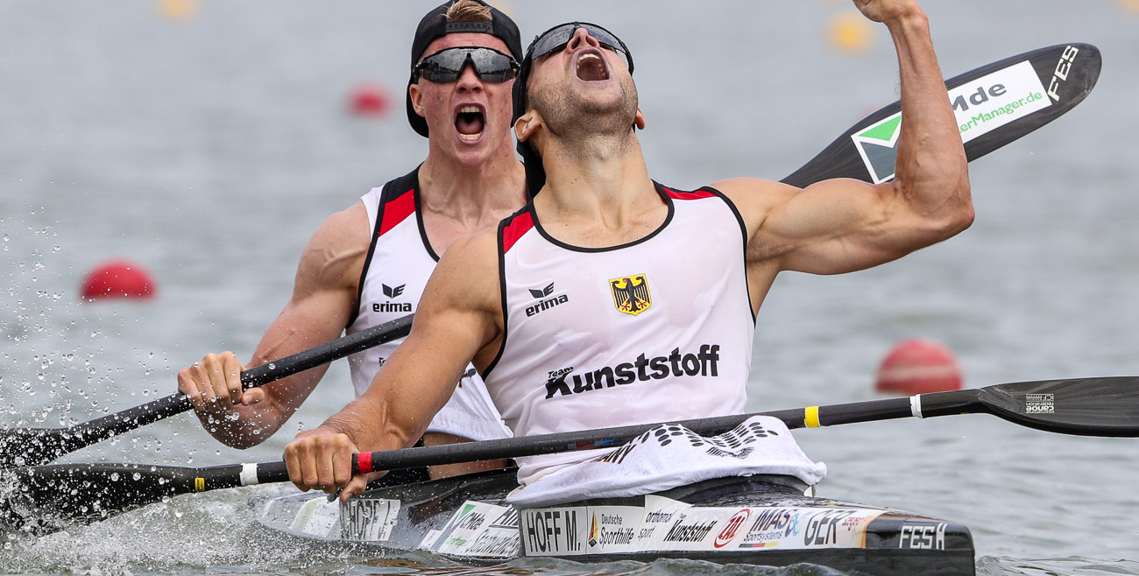
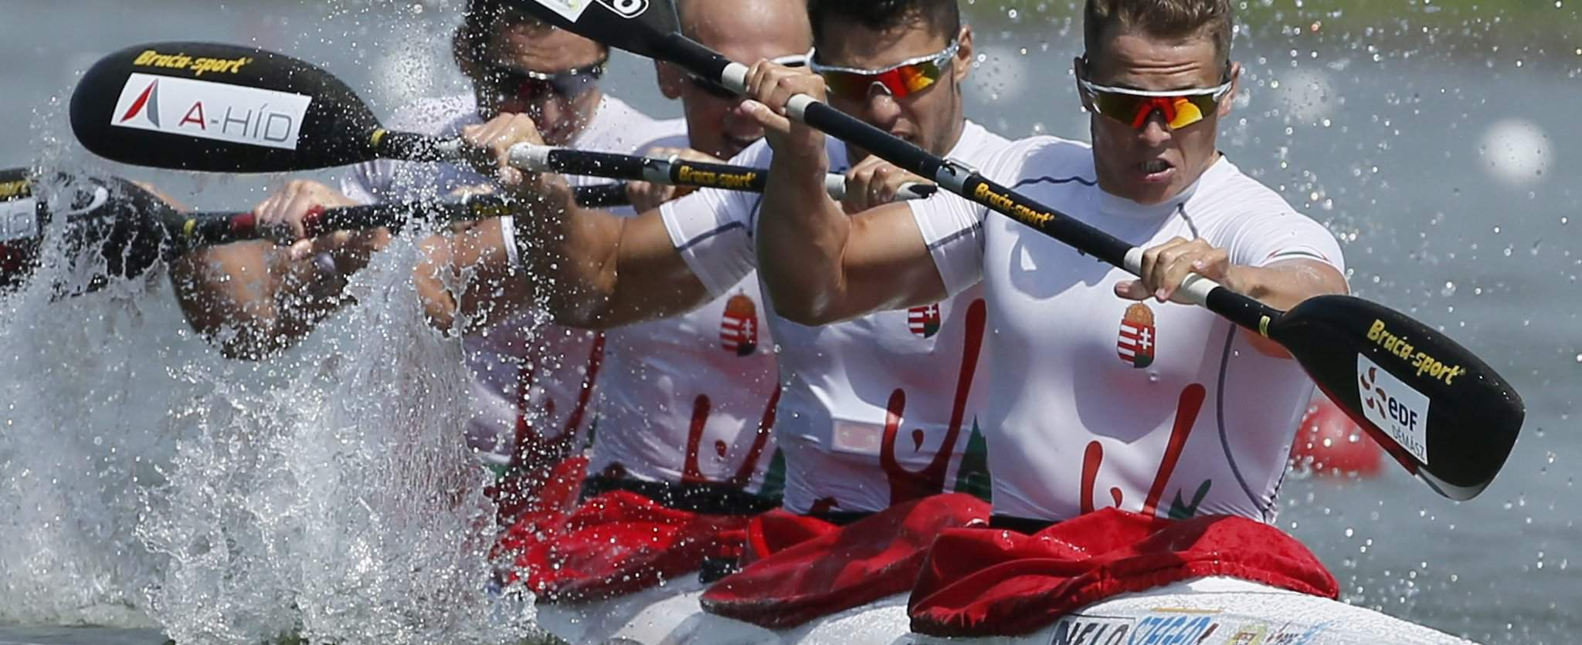
Kayak
These are the most famous kayakers of all time in Hungary
Bálint Kopasz
Tamara Csipes
Danuta Kozák
Rudolf Dombi
Roland Kökény
Bence Nádas

Slide 3
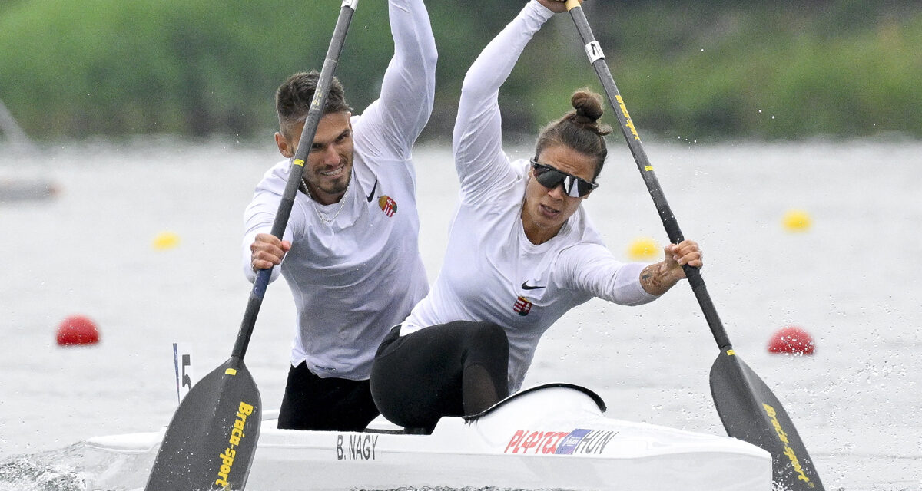
Canoeing
Hungarian Canoeing Achievements:
Hungary has won a total of 29 Olympic gold medals in canoeing, making it one of the top performing nations in the sport.
Canoe sprint events like the 500m and 1000m races have seen Hungarian athletes reguarly stand atop of the podium

Slide 4
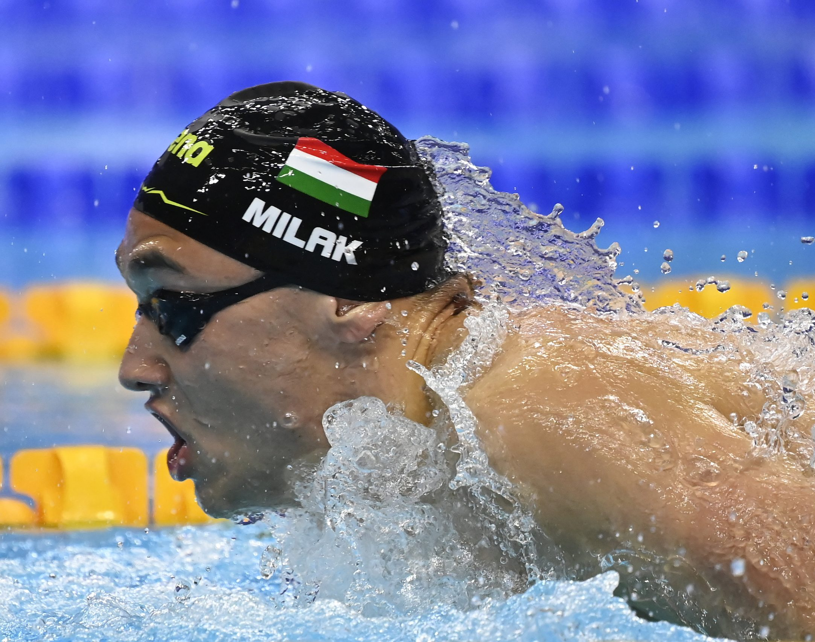
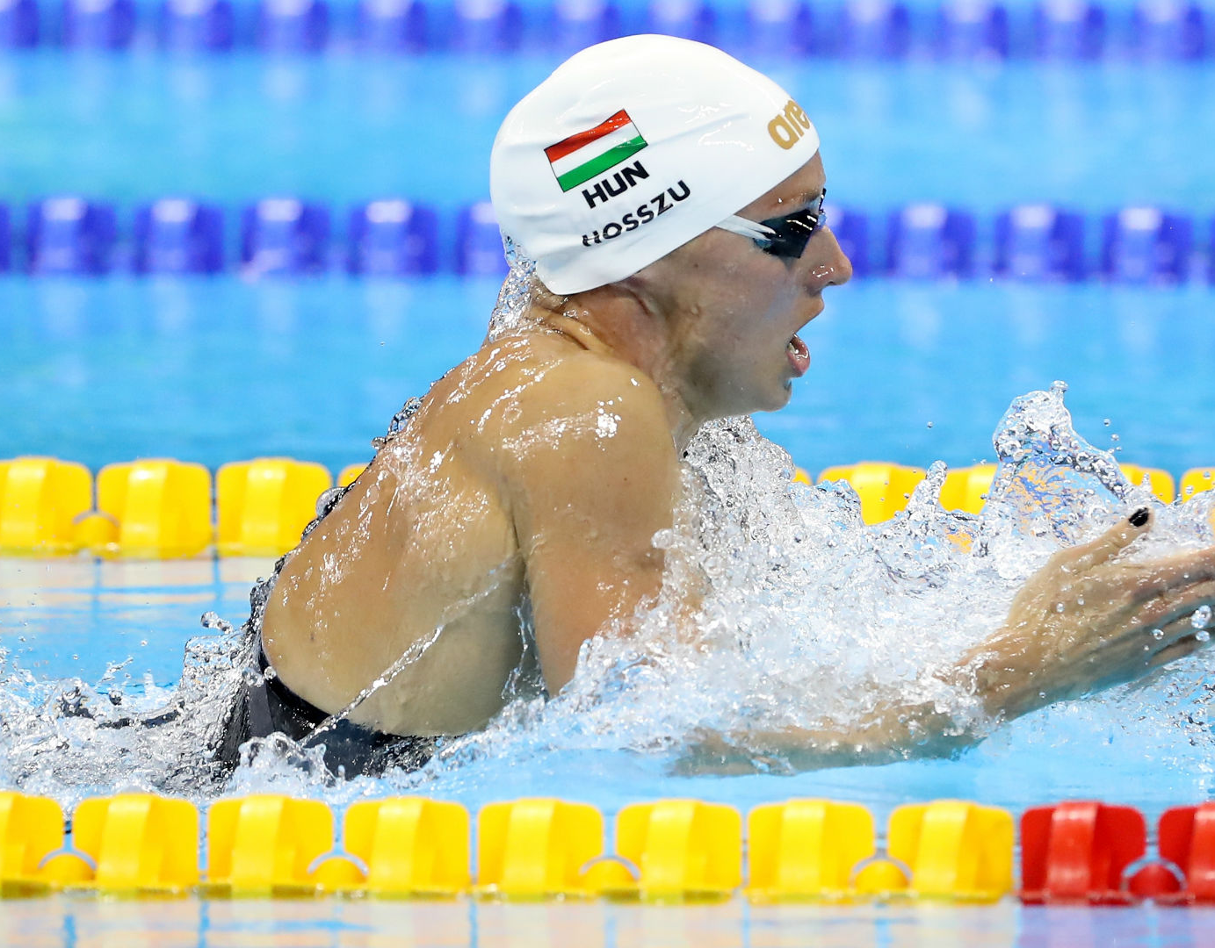
Swimming
Here are some of the most iconic Hungarian swimmers in history:
Krisztián Páll
Katinka Hosszú
László Cseh
László Cseh
Hubert Kos
Milák Kristóf

Slide 5
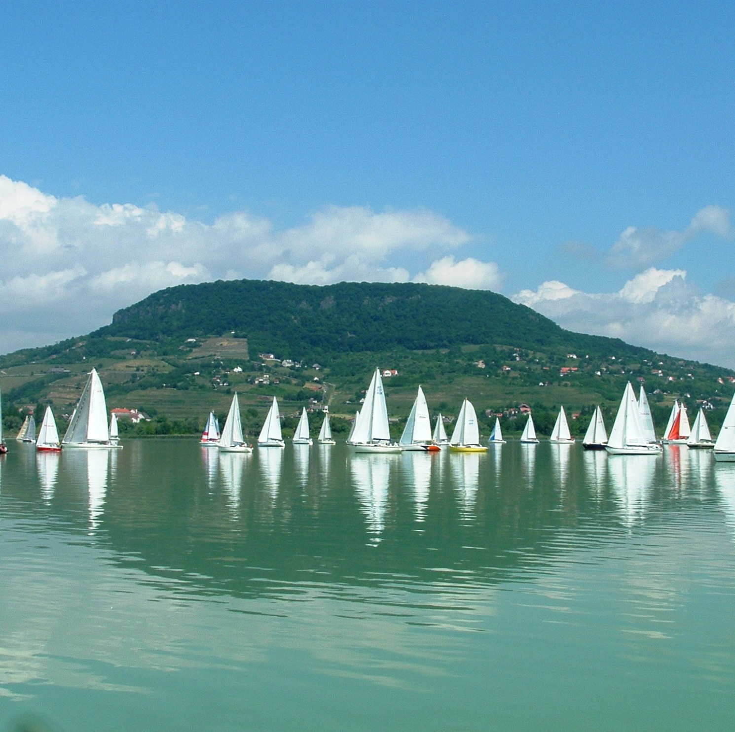
Sailing
Famous Hungarian sailor
Károly Papp: A notable figure in Hungarian sailing, Papp has participated in many international competitions and is regarded as a key figure in the Hungarian sailing community.

Slide 6
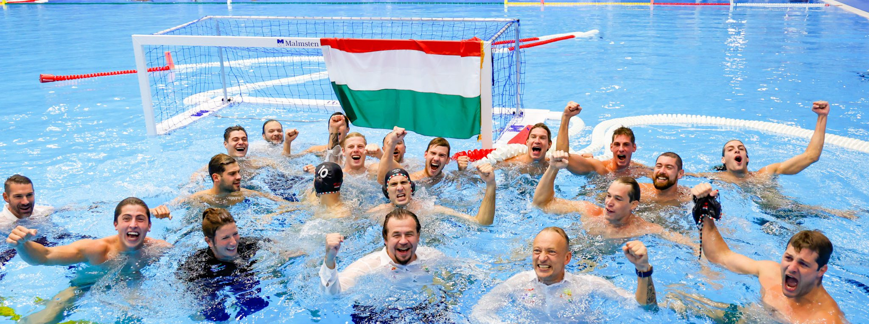
Water polo
Hungary’s water polo legacy is one of the richest and most successful in the sport's history. With a proud tradition of Olympic victories, world titles, and European supremacy, Hungary continues to be a dominant force in international water polo.

Slide 7
Thanks for the attention

