Slide 1
Water pollution

Slide 2
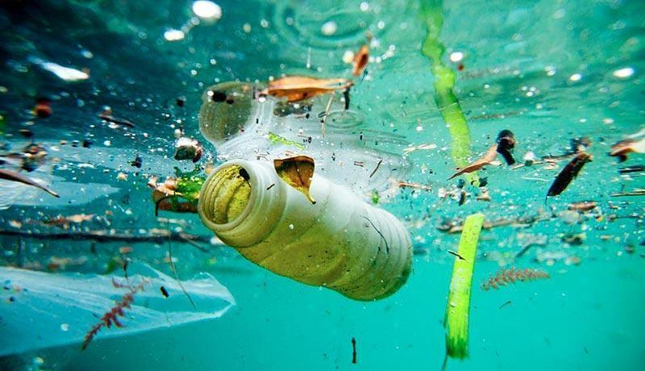
What is water pollution?
Water pollution changes the quality of surface and groundwater by making the water unsuitable for human use and disrupting life processes within it.

Slide 3
Ways of occurrence:
Industrial pollution
Agricultural pollution
Municipal waste (households)
Natural disasters
Oil pollution

Slide 4
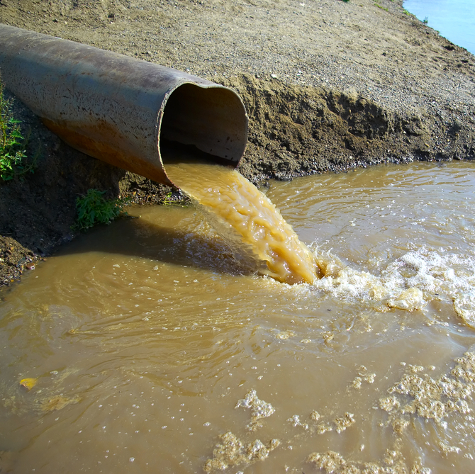
Industrial pollution
Harmful substances and chemicals generated during industrial activities enter the water
Wastewater

Slide 5
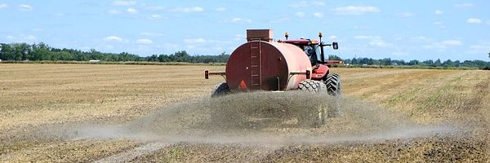
Agriculture
Chemicals, herbicides, pesticides, fertilizers used in agricultural enter the surface water.

Slide 6
Municipal waste (households)
Wastewater generated by human activities that are not properly treated or cleaned like use of detergents and cosmetics.

Slide 7
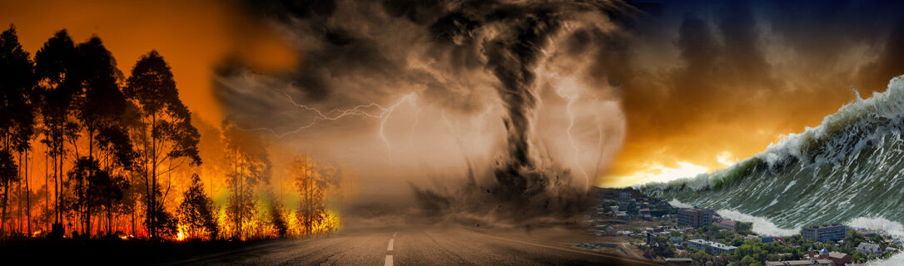
Natural disasters:
Floods, earthquakes, hurricanes,and other disasters introduce pollutants into the water.

Slide 8
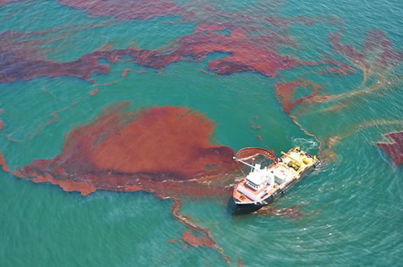
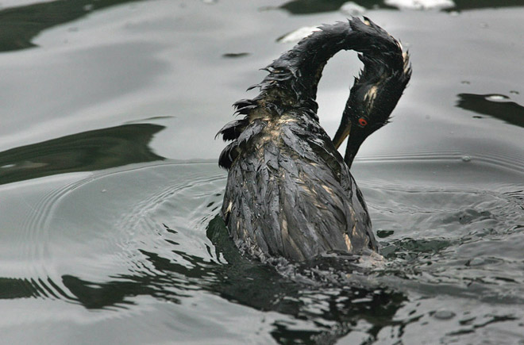
Oil pollution:
When ships are damaged in some way, large quantities of crude oil and oil derivatives enter the water.
The oil floats on the surface, blocking the sun's rays, hindering the healthy life of aquatic organisms, also contaminates the feathers of water birds.

Slide 9
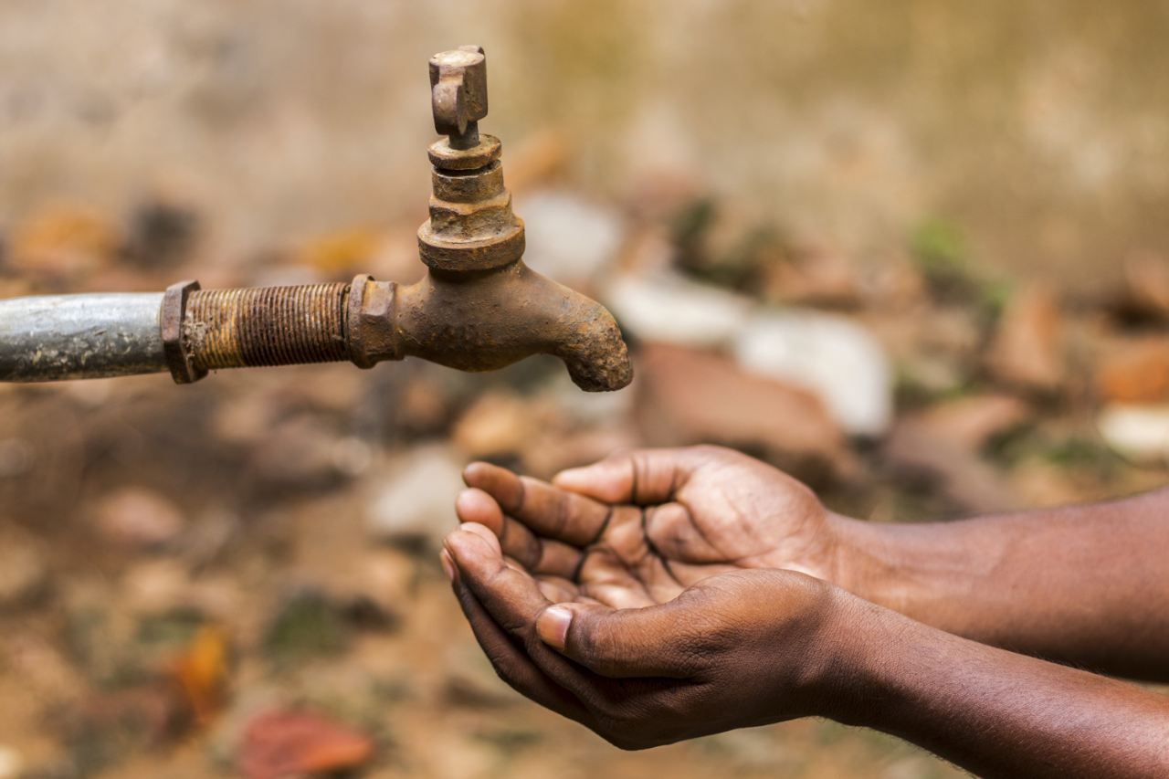
Consequences of water pollution:
Water becomes unsuitable for human consumption and agricultural purposes Destroys aquatic life.

Slide 10
Thank you for your attention!

