Slide 1
Understanding Climate Change:
Impacts and Solutions
By: Novák Benedek from the class 9B in KLG

Slide 2
Introduction to Climate Change
Definition of climate change:
Climate change is the long-term alteration of Earth's climate, largely due to human activities like burning fossil fuels and deforestation.
Causes are:Greenhouse Gas Emissions, Deforestation, Industrial Processes, Agriculture, Land Use Changes, Waste Management

Slide 3
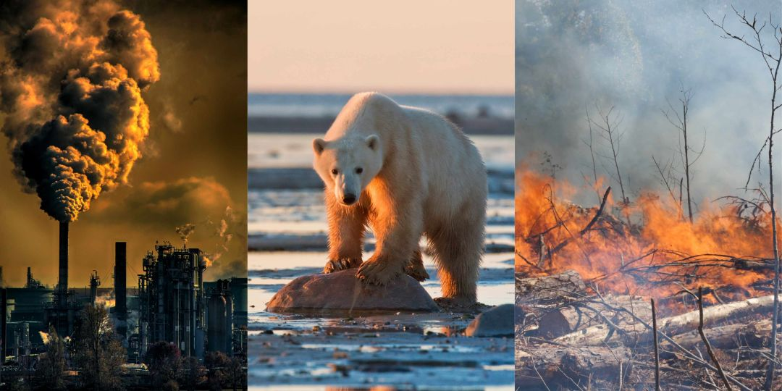
Evidence of Climate Change
Temperature rise
Melting ice caps
Extreme weather events
Rising sea levels
Ocean Acidification
Glacial Retreat

Slide 4
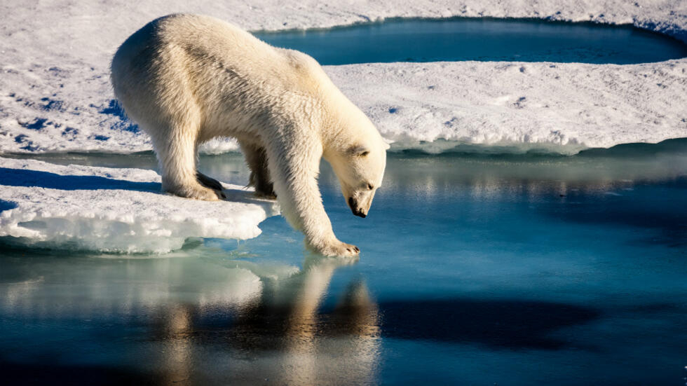
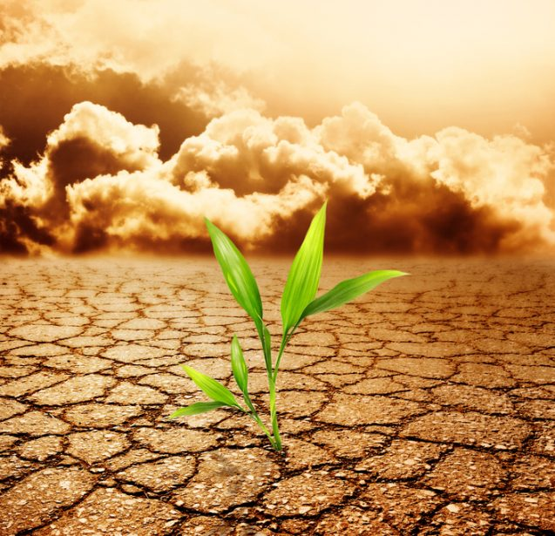
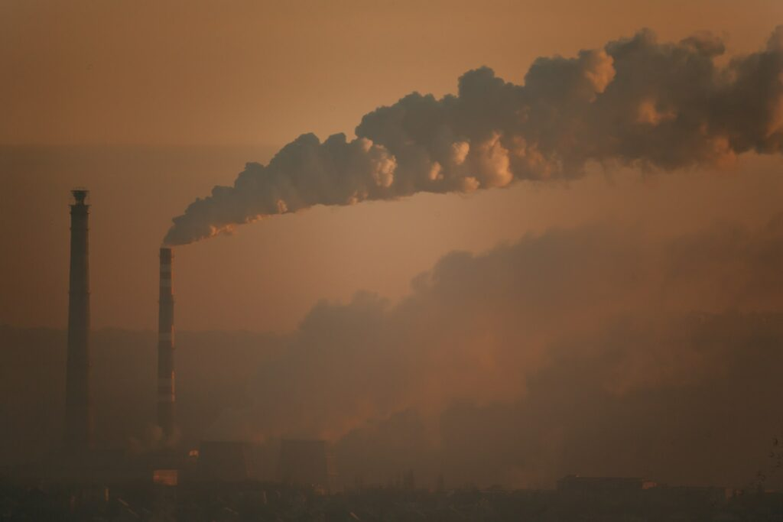
Impacts of Climate Change
Environmental impacts
(loss of biodiversity, habitat destruction)
Economic impacts (agricultural losses, property damage)
Social impacts (displacement, health effects)

Slide 5
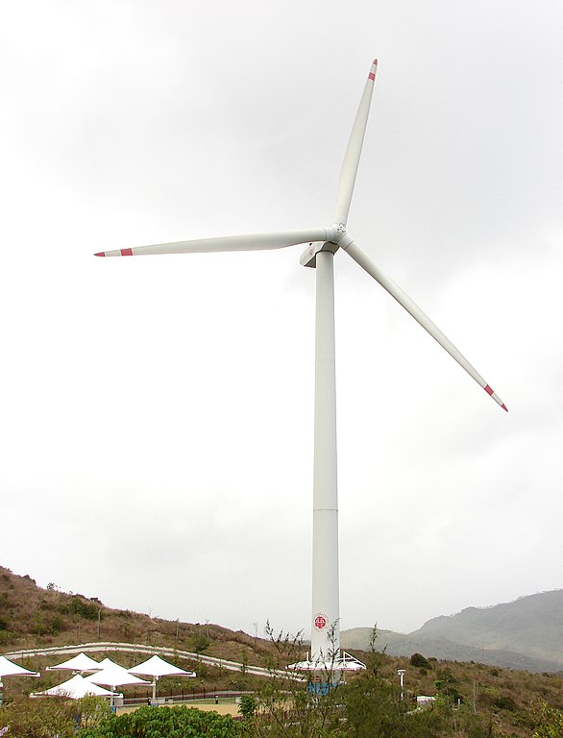
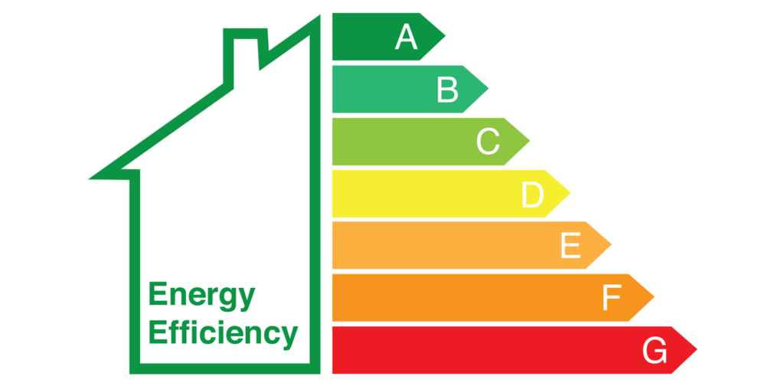

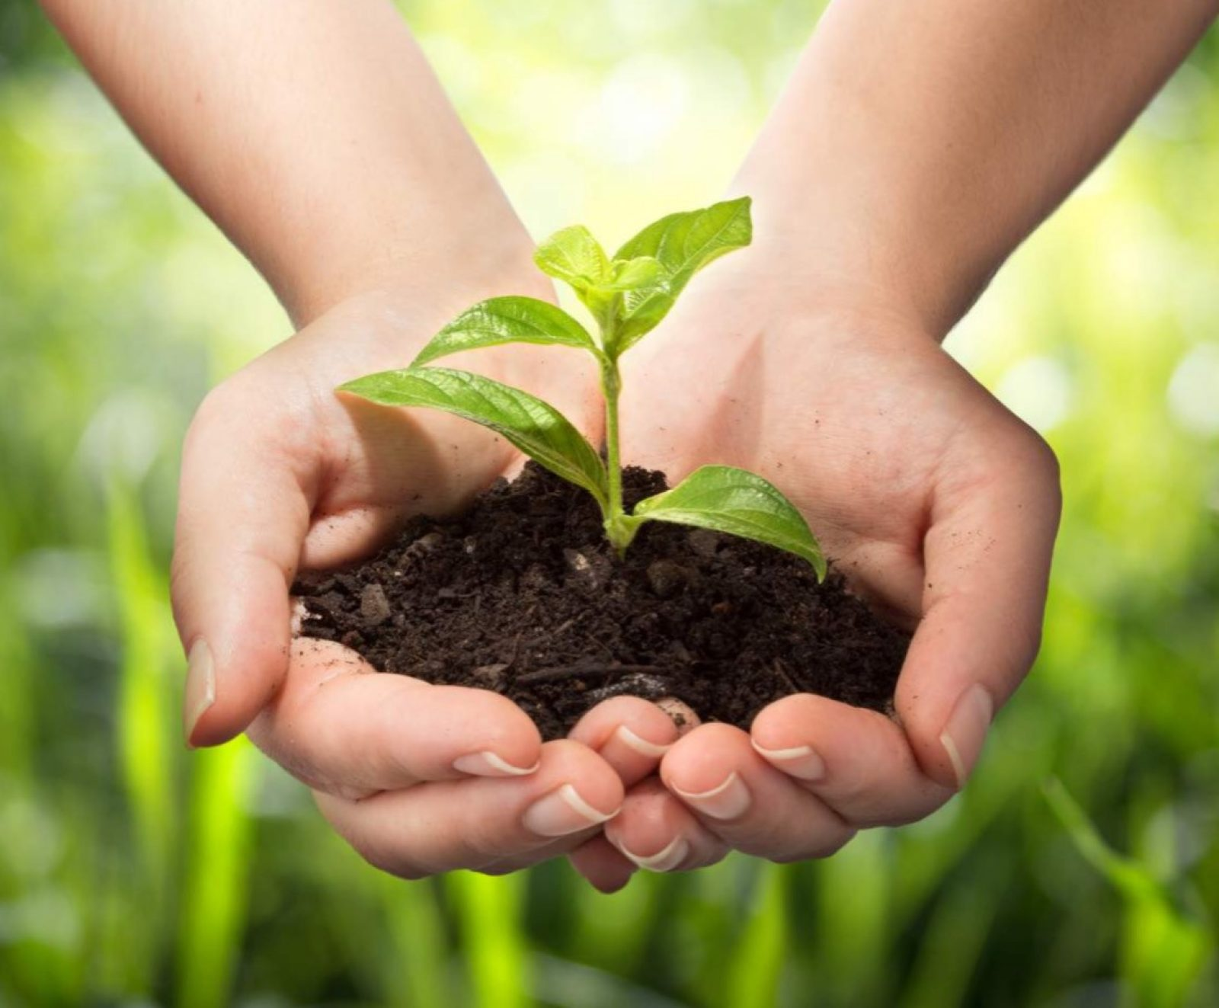
Solutions to Climate Change
Renewable energy adoption
Energy efficiency measures
Reforestation and afforestation
Sustainable agriculture practices

Slide 6

What can you do?
Reduce
, recycle
, reuse
Energy conservation at home
Encouraging and informing others

Slide 7
Take action today!
Thank you for your attention

